Slide 1
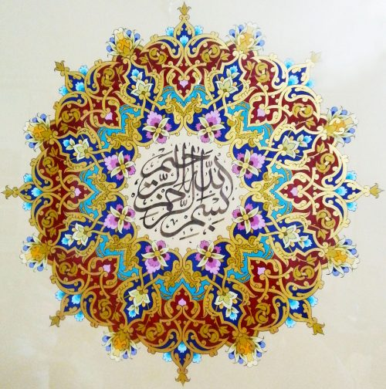
In the name of Allah

Slide 2
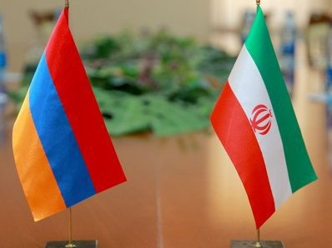
I.R.IRAN and Armenia;
Bilateral relations
Opportunities and Challenges
Presented by:
Mohsen Pakparvar
December 2017 – Yerevan
Director of Central Asia and Caucasus studies group
Institute for Political and International Studies (IPIS)
Ministry of Foreign Affairs, I. R. Iran
E-mail: pakparvar@yahoo.com,

Slide 3
Content
IRAN At Glance
Armenia At Glance
Bilateral Relations
Opportunities and challenges
Conclusion and Suggestions

Slide 4
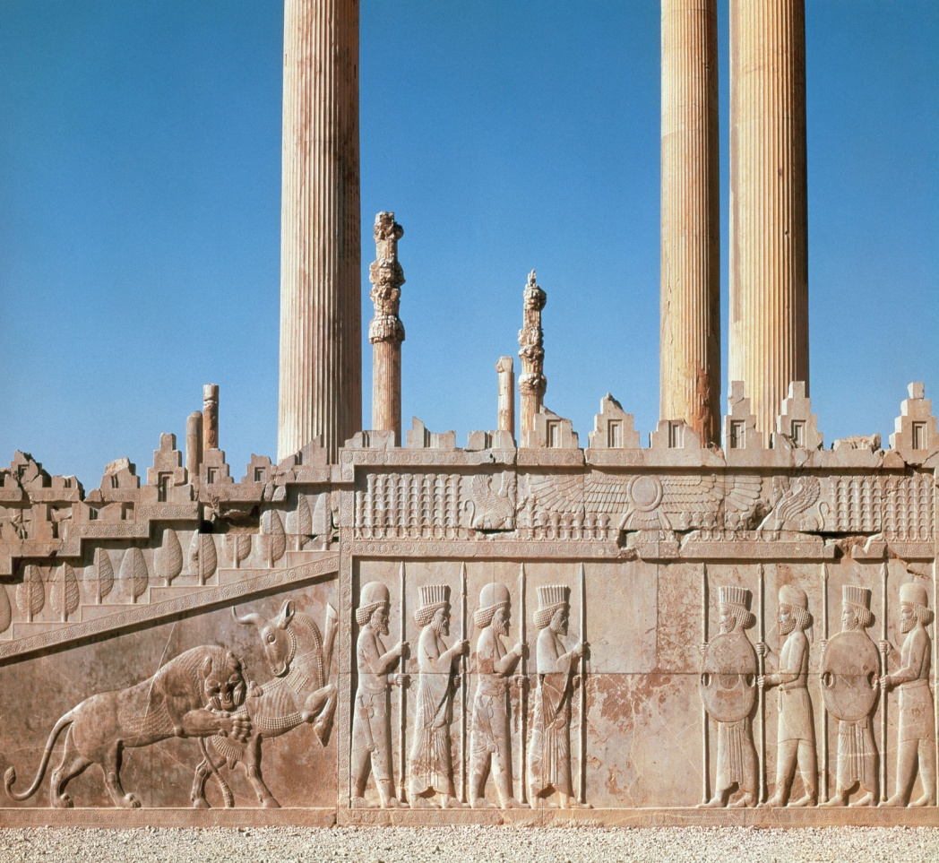
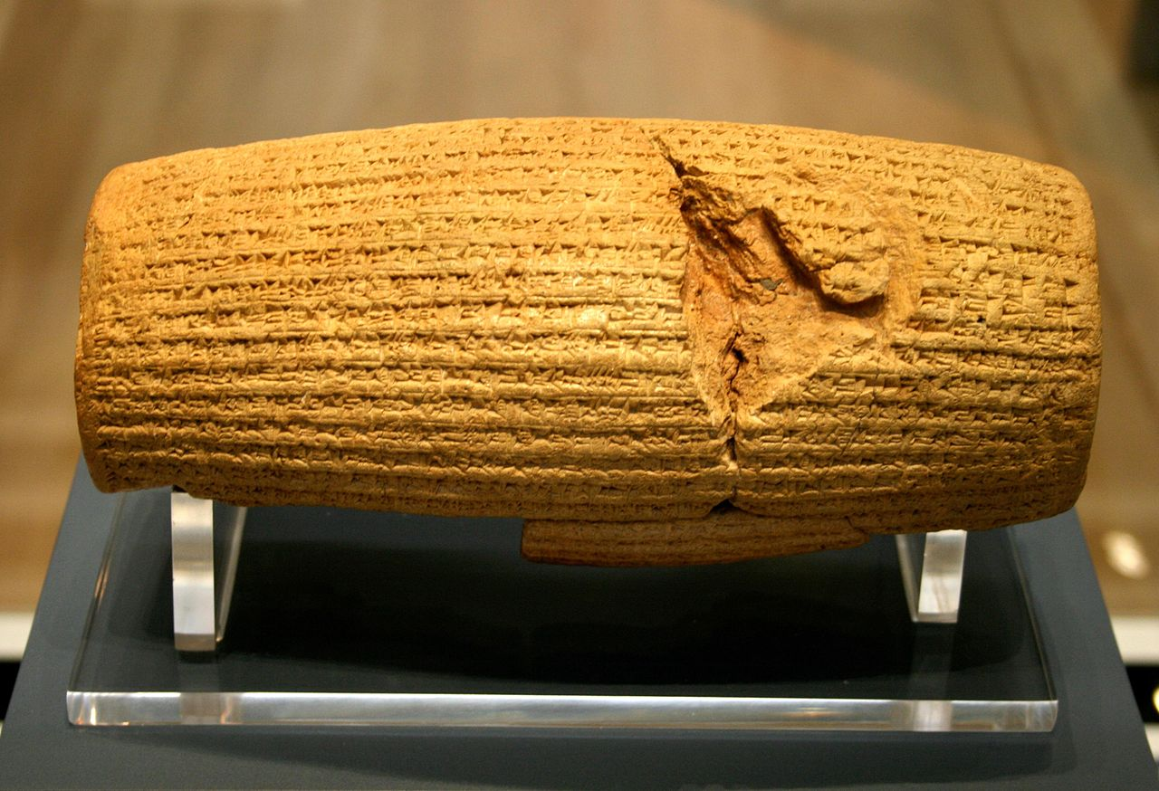
Persepolis
The Cyrus Cylinder is a document issued by Cyrus the Great and known as The First Charter of Human Rights

Slide 5
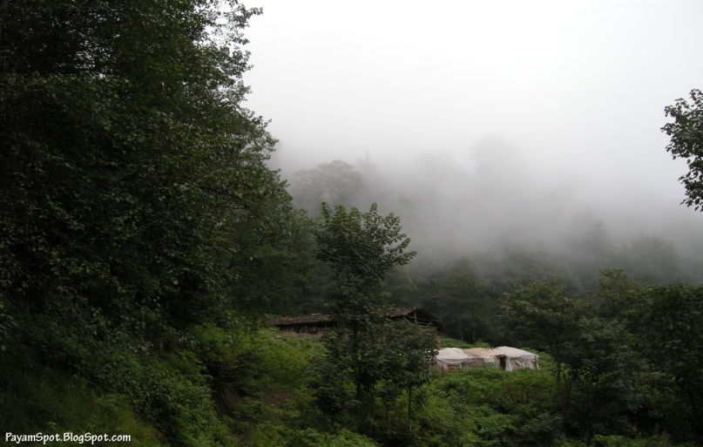

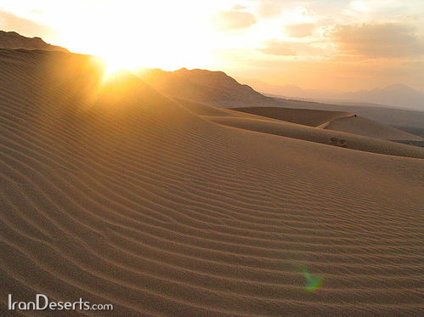
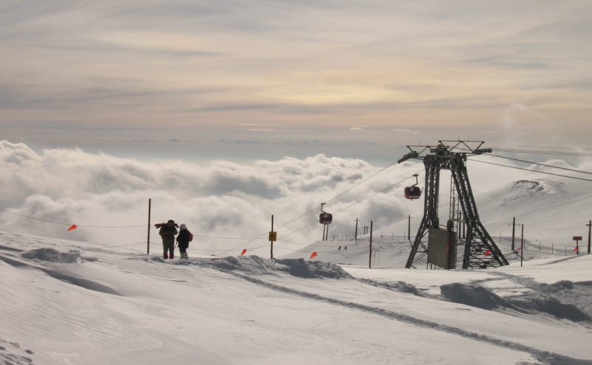
A Country for All Seasons

Slide 6
IRAN AT GLANCE

Slide 7
General information
Official name | Islamic Republic of Iran
Head of State | H.E. Dr. Hassan Rouhani
National Day | February 11th (Islamic Revolution of Iran-1979)
Capital | Tehran
Area | 1,648,196 sq km
Land boundaries | General information4,137 km
Sea boundaries | 2,700 km (Including the Caspian Sea)
River boundaries | 1,918 km
Border countries | Afghanistan, Azerbaijan , Armenia, Iraq, Pakistan, Turkey, Turkmenistan +10 sea neighbors
Climate | Mostly arid or semi-arid, temperate along Caspian coast and mountainous temperate along west and north-west.

Slide 8
Economic Index
Natural resources | Petroleum, natural gas, coal, chromium, copper, iron ore, lead, manganese, zinc, sulfur
Arable land | 300,000 sq. Km 18.2%
Meadows and pastures | 900,000 sq. Km 54.6%
Forest and woodland | 120,000 sq. Km 7.3%
Other | 258,000 sq. Km 15.7%
Irrigated land | 70,000 sq. Km 4.2%
Agricultural products | Wheat, rice, barley, potato, grains, sugar-beet, cotton, fresh & dried fruits, dates, pistachio, Saffron, nuts, poultry, meat, dairy products, wool; caviar, flowers and medicinal plants.
Population | 80 million (2017)
Population growth rate | 1.30% (2016)
Average age | 30 Yrs. (60% bellow 35 Yrs.)
University educated | 14,000,000
Annual university capacity | 1,300,000 (300,00 Engineers,2nd in the world)
Oil & Gas Reserves | Oil 10%, Gas 18% (1st in the world Energy)

Slide 9
Religions | Muslim 99.56% Zoroastrian, Christian & Jewish 0.44%
Languages | Persian, and Persian dialect ((Azeri, Kurdish, Lori, Balouchi, Arabic
Literacy (2015) | Total 92%
Currency | Rial (IRR 35659=1$)
GDP | 412.2 billion US$ (2016)
GDP per capita | 5442 US$ (2014)
GDP growth rate | 7.8 % (2016)
Total Imports | 43 billion US $ (2016)
Total Exports(non Oil) | 43 billion US $ (2016)
FDI (approved) | 12 billion US $ (2016)
Electricity | Production: 65000 MWH (2016)
Railways networks | 15000 km (2016)
Road networks | 250000 km (2016)
Ports | 11 commercial ports

Slide 10
Countries | Imports ) B$(
China | 10.4
UAE | 7.7
South Korea | 4.67
Turkey | 2.98
Swiss | 2.39
India | 2.29
Germany | 1.82
Italy | 0.9
France | 0.76
Russia | 0.58
Pakistan | 0.22
Armania
Uzbekistan | 0.044
Kirghizstan | 0.004
Total | 42.53

Slide 11
Countries | EXPOSRT {NON OIL} (B$)
China | 7.6
UAE | 7.23
Iraq | 6.22
Turkey | 3.36
India | 2.68
Afghanistan | 2.56
Japan | 1.19
South Korea | 0.87
Turkmenistan | 0.71
Pakistan | 0.67
Uzbekistan | 0.23
Azerbaijan | 0.23
Armenia | 0.197
Russia | 0.173
Tajikistan | 0.15
Kazakhstan | 0.13
Kyrgyzstan | 0.022
Total | 42.42

Slide 12
Facts and figures
For more than 25 years, the Islamic Republic of Iran has appeared as reliable ally of the republic of Armenia.
Iran recognized Armenia’s independence on December 25, 1991.
All of Iranian President had formal visit to Yerevan since Armenia Independence.
Two countries have strengthened their political relationship on many occasions and have committed themselves to realize numerous common projects in the economic field.
The volume of trade exchanges between Iran and Armenia had increased steadily for the last 25 years, total reached the level of 1 billion.
The two countries also significantly improved their transport routes.
According to the Directorate General for Trade of the European Commission, Iran is the fourth major trade partners of Armenia.

Slide 13
Top 5 Export and Import partners
Market | Trade (US$ M) | Partner share(%)
Russian Federation | 373 | 20.63
Bulgaria | 163 | 9.04
Georgia | 141 | 7.81
Iraq | 141 | 7.77
Germany | 135 | 7.47
Exporter | Trade (US$ M) | Partner share(%)
Russian Federation | 991 | 30.78
China | 363 | 11.29
Turkey | 169 | 5.25
I.R.Iran | 165 | 5.12
Germany | 160 | 4.98

Slide 14
Armenia trade statistics with Iran
year | 2008 | 2009 | 2010 | 2011 | 2012 | 2013 | 2014 | 2015 | 2016
export | 151/7 | 97/9 | 113/9 | 103/9 | 119/1 | 108 | 109/4 | 112 | 204
imports | 26/2 | 28 | 42/4 | 32/6 | 28/7 | 29/3 | 15/2 | 20 | 13
Trade balance | +125/5 | +69/9 | +71/5 | +71/3 | 55 | +78/7 | 94/2 | 92 | 191
foreign trades | 177/9 | 125/9 | 156/3 | 136/5 | 147/8 | 137/3 | 124/6 | 132 | 218

Slide 15
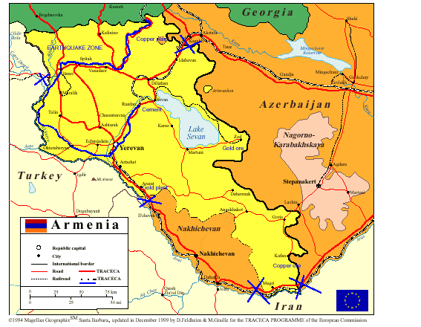

Slide 16
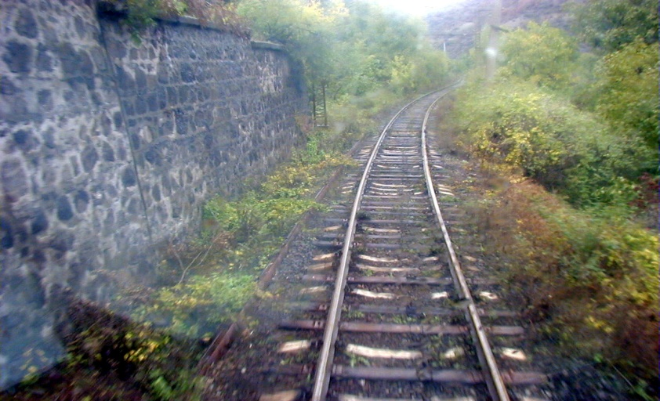

Slide 17
Opportunities and challenges

Slide 18
Opportunities-from I.R.Iran
Iranian Knowledge based companies to provide high tech and technical goods, employments, know how
Iran Engineering capacities in Mining , Energy, Road and transport, construction ,capacity bundling and infrastructures.
More than 7 Million Iranian tourists trip to abroad annually.
Iranian unique historical , religious , natural sight seeing and cultural background.
High level and world class industries such as machineries, technical tools, Auto industry, industrial equipments. …
Good will of Iranian government to enhance its neighborhood relationship and priority of neighboring countries in new government.

Slide 19
Opportunities-from Armenia
Armenia is a country with a unique and diverse historical and cultural heritage, which has developed into a remarkable culture at the crossroads of East and West.
Good capacity in natural mineral and water resources
Armenia has one of the most favorable legislative regimes for foreign investment
.among European countries
Armenian ﬁnancial sector provides favorable infrastructure for investments in
the country
Armenia has the role of transportation hub in the region and a transit partner of EU, EAEU, Middle East and Asian countries, which is supported by current infrastructure

Slide 20
Challenges
1. The existence of tariff barriers between the two countries
2. The existence of customs problems
3. Problems in transferring the export and import goods
4. Armenian difficult tax laws
5. Inactive commercial mechanism, such as joint chamber of commerce
6. Interfering of regional and ultra regional power in bilateral
relations
7.Nagorno-Karabakh conflict

Slide 21
Conclusion& Suggestions

Slide 22
Suggestions
Development of cooperation between the two countries' investors in the free zones
Development of transit cooperation
Bilateral cooperation on river environment
Development of banking and insurance cooperation
Opening the Joint Business Council between the two countries
Exchanging business delegation between two countries
Mediation in Iran Nagorno-Karabakh conflict

Slide 23
Conclusion
Both countries have a vast opportunities and could complete each other.
Iran with huge potential in natural resources; and Energy, with considerable human resource capacity such as engineering , scientific and high technology could be valuable asset for Armenia.
The proximity of the political views of the two countries to regional and
.international organizations together
.Cooperation in the field of dam and factory construction
The main role of Iran in solution of Nagorno-Karabakh conflict between Azerbaijan and Armenia Nagorno Karabakh conflict between Armenia and Azerbaijan.
It is also worth mentioning that tens of thousands of Armenians live in Iran, where they enjoy a certain amount of political and religious protection.

Slide 24

Vote of thanks
Government of Republic Armenia
Ministry of foreign affairs of Armenistan
Noravank Foundation
Embassy of I.R. Iran in Yerevan
All organizer and facilitator & Participants
Looking forward for strong relationship between IPIS & Noravank Foundation
For any comment please contact:
pakparvar@yahoo.com

